Slide 1
Chronic Hepatitis B Infection Predictive Modeling
Ying Xiang & Jack Gschwendtner

Slide 2


What is Hepatitis B?
Chronic Hepatitis B Virus (HBV) -> liver cancer/failure or cirrhosis
Many people are asymptomatic
Trying to diagnose, treat, and potentially cure more people
Expensive to screen blood samples
Spread through bodily fluids

Slide 3

Methods
R coding
Lasso
Random forest
Ordinary Linear regression

Slide 4
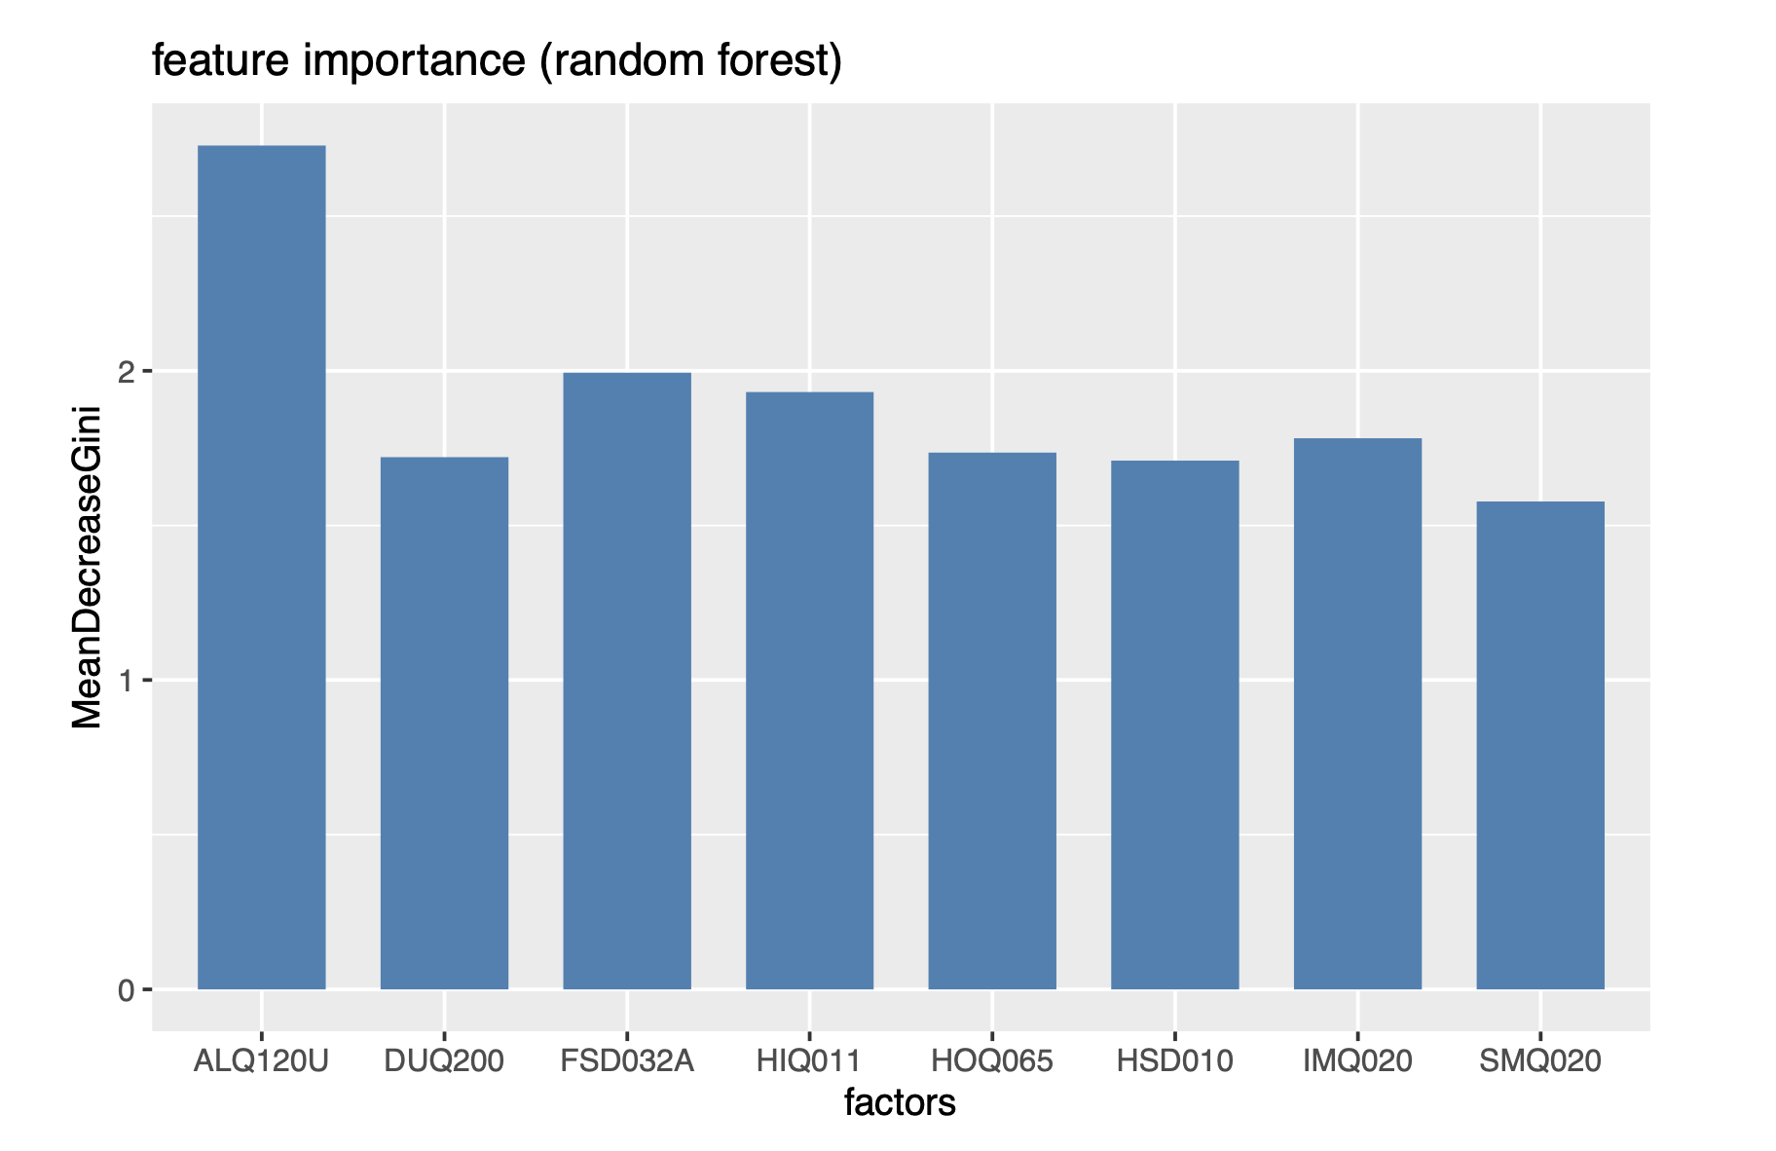
Random forest Output
ALQ – Alcohol
FSD – Food Security
HIQ – Health Insurance
IMQ – Immunization
HOQ – Homeowner
DUQ – Drug Use
HSD – Current health status
SMQ - Smoking

Slide 5
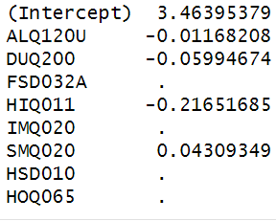
LASSO Output
10-fold cross validation
lambda.min
ALQ – Alcohol
HIQ – Health Insurance
DUQ – Drug Use
SMQ - Smoking

Slide 6
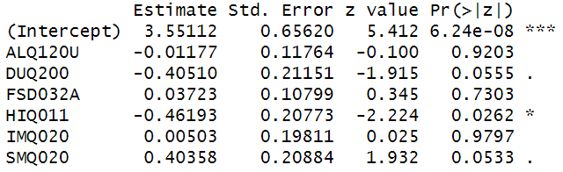
ordinary linear regression
HIQ – Health Insurance
DUQ – Drug Use
SMQ - Smoking

Slide 7


Significant Variables
Drug Use
Health Insurance
Smoking
Needles
Drug Preparation Equipment
Doctors Appt.
HBV Screening
Bad for health
Liver Cancer

Slide 8


Insignificant Variables
Food Security
Immunization
Alcohol
Homeowner
Current health
Hep B spread through bodily fluids
Needles
Sexual activity
Mother to child at birth

Slide 9
Sources
https://www.cdc.gov/nchs/images/dhcs/drug-use/drug-use.jpg?_=67388
https://magazine.medlineplus.gov/images/uploads/main_images/Alcohol_use-main.jpg
https://www.nchealthinfo.org/wp-content/uploads/2019/08/Immunization.jpg
https://www.cdc.gov/hepatitis/hbv/index.htm#:~:text=Hepatitis%20B%20is%20spread%20when,or%20during%20pregnancy%20or%20delivery
https://www.who.int/news-room/fact-sheets/detail/hepatitis-b

